Slide 1
Climate Change
Presented by:
Shilpa, Carmen, Mingma, Aleksandra, Katarzyna, Lei
Notes:
Hi everyone,
I am Shilpa. Today, Alex and I are presenting the “Climate Change” analysis behalf of our team which includes Carmen, Mingma, Katarzyna, Lei, Aleks and myself.

Slide 2

Agenda
01
Problem Statement
02
Important Factors
03
Data Analysis
04
Graphs & Models
05
Prediction
Notes:
In this presentation, we will define our problem statement, talk about the important factors to consider for the analysis, deep dive into data analysis and related graphs and models. Towards the end, Aleks will walk us through the machine learning prediction model on some of the key factors influencing climate change.

Slide 3
Problem Statement
Notes:
Let’s define the problem statement

Slide 4
Problem Statement
What are the key influencing factors of climate change in the United States? Does Carbon emission, increase in population, energy consumption and meat consumption have any correlation to climate change?
Meat Consumption
Population Increase
CO2 Emission
Energy Consumption
...and more
Notes:
What are the key influencing factors of climate change in the United States? Does Carbon emission, increase in population, energy consumption and meat consumption have any correlation to climate change?

Slide 5
Possible Variables to Consider
Petroleum Consumption
Coal Emission
Deforestation
Population Growth
Fertilizer Use
Arctic Ice
Meat Consumption
Fossil Fuels
Greenhouse Emission
Daily Temperatures
Snowfall
Precipitation
Notes:
We started with a hypothesis matrix where we brainstormed as a team to come up with multiple factors that could define and influence climate change. We came up with many variables, some of which are on the slide here, such as daily temperature, snowfall, carbon emission, fossil fuels, population growth and meat consumption

Slide 6
Important Factors
Notes:
To solve the problem, we came up with a solution framework containing important factors.

Slide 7
Three Components
Evidence
Causes
Impact
Supporting data & graphs to show climate change is real
Climate change escalation in recent three decades
Possible correlations to factors like meat consumption, co2 emission, energy consumption, population...and others
Look for anomalies and act upon them
Understanding the factors in order to prevent them
Notes:
The three important factors are –
Evidence
Causes
Impact
Evidence includes supporting data to show climate change is real and it is escalating
There is a need to identify the causing factors such as Co2 emission, energy consumption and other factors
By measuring the impact we can prevent further degradation of the situation

Slide 8
Data Analysis
Notes:
Let‘s deep dive into the data analysis for these three factors

Slide 9
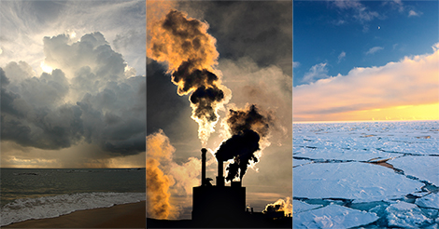
What is the evidence for
the climate change?
Evidence
Notes:
First – Evidence. What is the evidence for the climate change?

Slide 10
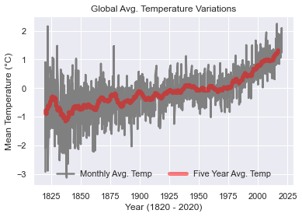
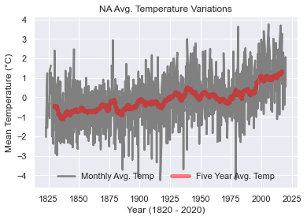
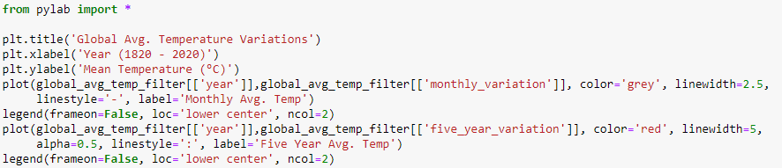
Climate Change is Real
Notes:
When we plotted the time series plot for monthly average temperature, we found that it was increasing over the past 3 decades more than previous decades. This shows that the change is not natural anymore. It is an anomaly. To the left we have global trends and to the right we have North America trend. Both show the same trend and provide the evidence that “Climate change is real”
For questions only –
Mean Temperature: Estimated Jan 1951-Dec 1980 absolute temperature (C): 8.61
# Estimated Jan 1951-Dec 1980 monthly absolute temperature (C):
# Jan Feb Mar Apr May Jun Jul Aug Sep Oct Nov Dec
# 2.61 3.22 5.30 8.30 11.30 13.44 14.31 13.84 12.05 9.21 6.07 3.64

Slide 11
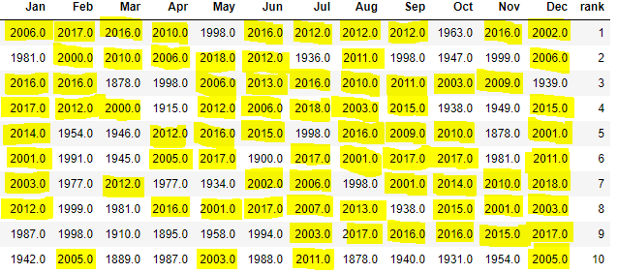
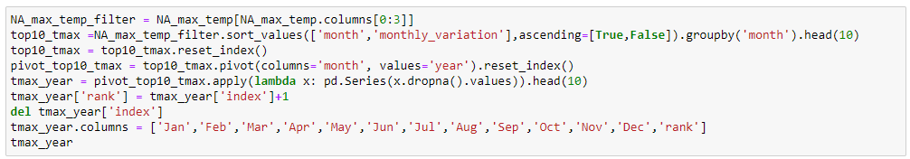
Climate Change is Real
Hottest Years in Each Month Ranked From Top to Bottom (1820 to 2020)
Notes:
If you are convinced with previous chart, let me show you a table with more jaw-dropping insights. The table here contains “hottest years in each month ranked from 1820 – 2020.” In this list of top 10 years, January has 7 out of 10 instances where year is after 2000. And in July, 8 out of 10 instances have years are greater than 2000 and in December it is 9 out of 10 times. This shows that United States have significantly warmed up in recent 20 years. Clearly an indicator that “Climate Change is Real.”

Slide 12
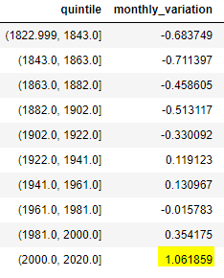
Climate Change is Real
Change in Average Temperature in ºC (1820 to 2020)
vs Mean Temperature between 1951 to 1980
Notes:
One last evidence, before we move into the next section. Here we have change in average temperature broken down by 20 years buckets. We see that during 2000-2020, there is 1 degree centigrade increase in average temperature compared to 1951 to 1980. If you are wondering, that’s not much of a difference, let me show you the impact of 1 degree centigrade on our earth.

Slide 13
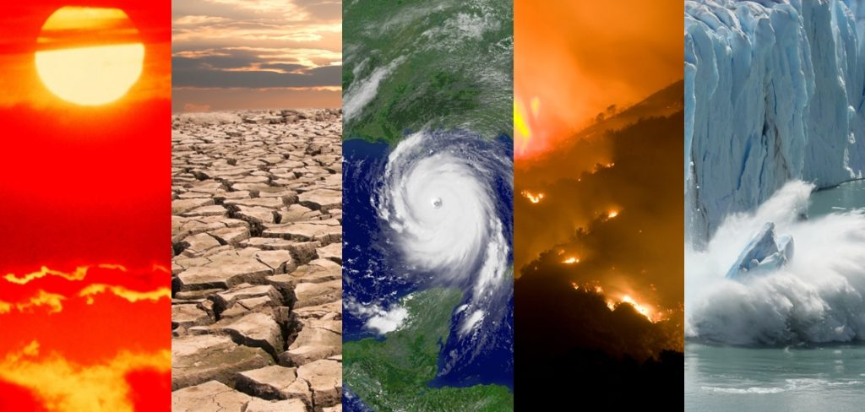
What is the
impact of
the climate change?
1-degree centigrade change means –
Heat Waves increase by 14%
61M people impacted by draught
187M-270M impacted by water scarcity
Extreme precipitation
Impact
Source: https://climate.nasa.gov/news/2865/a-degree-of-concern-why-global-temperatures-matter/
Notes:
From the post on NASA, we understood that 1 degree centigrade can increase heat waves by 14% YoY, potentially 61M people impacted by draught, 187M – 270M impacted by water scarcity and in few other cases observe extreme precipitation This is how serious the impact of 1 degree centigrade is.

Slide 14
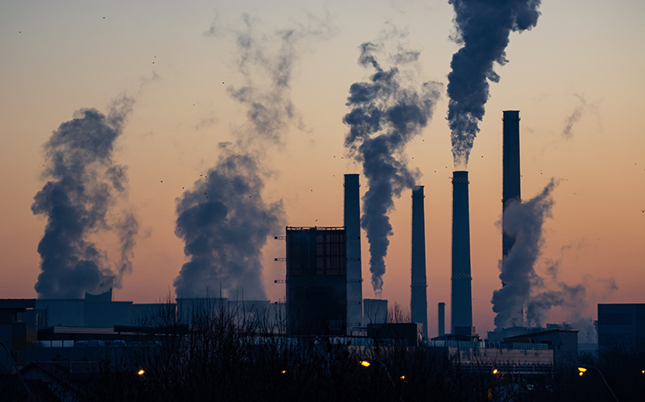
What are the
factors influencing
the climate change?
Causes
Notes:
Let’s deep dive now into the factors influencing the climate change.

Slide 15
Methodology
Collected climate change evidence variables such as maximum temperature, minimum temperature, average temperature, precipitation and snowfall at daily level from 1990 – 2020 for each state in United States
Performed K-means cluster analysis to create 4 meaningful segments such as –
Wet States
Global Warming States
Cold but Dry States
Unpredictable Weather States
Collected climate change influencing variables such as Co2 emission, Petroleum carbon emission, Natural gas carbon emission, Electricity carbon emission, Coal emission, Population, Natural gas consumption, Petroleum consumption, Coal consumption and Meat consumption from 1990 to 2020 (subject to availability) at a yearly level
Performed log-log linear regression model for each of the segments (that is 4 statistical models total) obtained from clustering analysis to understand the impact of the influencing variables. “Average of maximum temperature reached (TMAX_AVG)” is considered as the dependent variable
Notes:
Our methodology includes identifying similar states with similar degree of climate change by building a segmentation. We then built a regression model for each of the clusters obtained from the segmentation to identify the specific influencing factors causing climate change.
For this we first collected the data such as maximum temperature, minimum temperature, average temperature, precipitation and snowfall at daily level from 1990 – 2020 for each state in United States. Then performed K-means cluster analysis to obtain 4 meaningful segments such as Wet states, global warming states, cold but dry states and unpredictable weather states. We then collected independent variables to build a regression model. The independent variables include Co2 emission, Petroleum carbon emission, Natural gas carbon emission, Electricity carbon emission, Coal emission, Population and others. We performed log-log linear regression model with “Average of maximum temperature reached (TMAX_AVG)” as the dependent variable

Slide 16
Graphs & Models
Notes:
Let’s look at the results

Slide 17
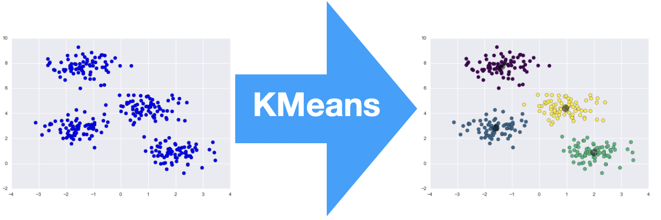
K-Means Clustering
Notes:
This is a simple and quick way to understand K-means, which is an unsupervised machine learning algorithm. K-means algorithm identifies k number of centroids, and then allocates every data point to the nearest cluster, while keeping the centroids as small as possible

Slide 18
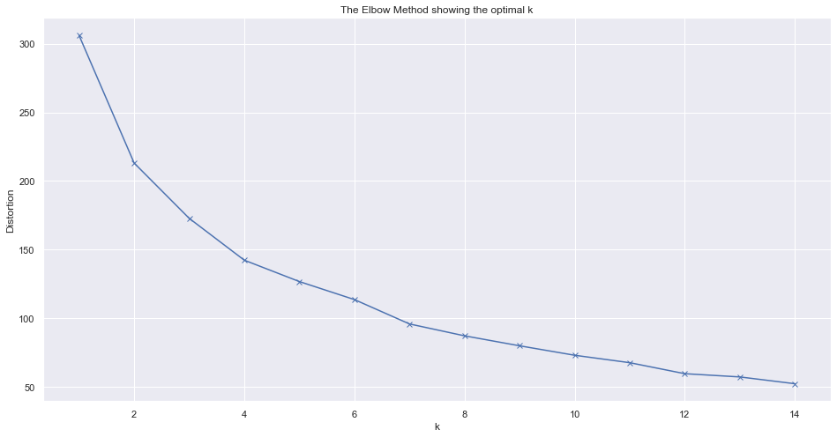
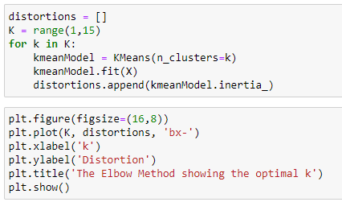
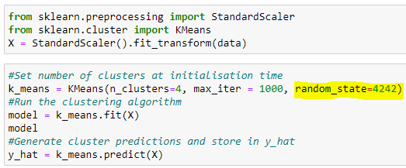
K-Means Clustering Setup
Segmentation Variables
Profiling Variables
Elbow Curve
PRCP_MAX
Maximum precipitation in a year
SNOW_MAX
Maximum snowfall in a year
TAVG_avg_yoy
Average temperature YoY change
(2010-2019 vs 2000-2009)
TMAX_max_yoy
Maximum temperature YoY change
(2010-2019 vs 2000-2009)
TMAX_avg_yoy
Average of maximum temperature YoY change
(2010-2019 vs 2000-2009)
TMIN_min_yoy
Miminim temperature YoY change
(2010-2019 vs 2000-2009)
PRCP_CHG
Maximum precipitation – Minimum precipitation in the same year
SNOW_CHG
Maximum snowfall – Minimum snowfall in the same year
PRCP_CNT_YoY
Number of days with precipitation change
(2010-2019 vs 2000-2009)
SNOW_CNT
umber of days with snowfall change
(2010-2019 vs 2000-2009)
Overall, 50+ variables to profile the clusters
Elbow method
K-Means Clustering
To reproduce
same result again
Notes:
For the kmeans set up, we have considered 6 variables which include YoY metrics that provide degree of change in the metrics from 2010-2019 to 2000-2009.
For profiling variables, we considered change variables that provide range defined maximum – minimum. Elbow curve method was used to identify the optimal number of clusters, which is 4 in this case.

Slide 19


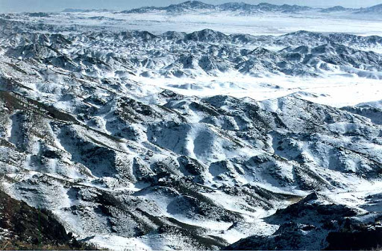

K-Means Insights
WET STATES
GLOBAL WARMING STATES
High rainfall in recent decade than before, change of 270 mm on average. Maximum temperatures increased by 0.82 degree centigrade. States are New Jersey, New York, Connecticut,
Massachusetts, Maryland and other 6 states
Snow days and quantity is reduced, and more precipitation was observed in the recent decade compared to previous. Minimum temperature went up 0.2-degree centigrade. The states are California, Alaska, Nevada, Michigan,
Oregon, Wisconsin, South Dakota and 8 other states
COLD BUT DRY STATES
UNPREDICTABLE WEATHER STATES
Average, minimum and maximum temperatures have gone down by 0.4 degree centigrade. Number of days with precipitation or snow went down. The states are Arizona, New Mexico and Colorado
Maximum temperature increased by 0.8-degree centigrade and fluctuated by 2.9-degree centigrade over the last decade. Heavy snow and precipitation concentrated over a brief period and overall increase in average temperature. The states are Florida, Texas, Illinois, Kansas, Ohio,
Tennessee, Virginia, Los Angeles and 14 other states
Notes:
The clusters are …

Slide 20
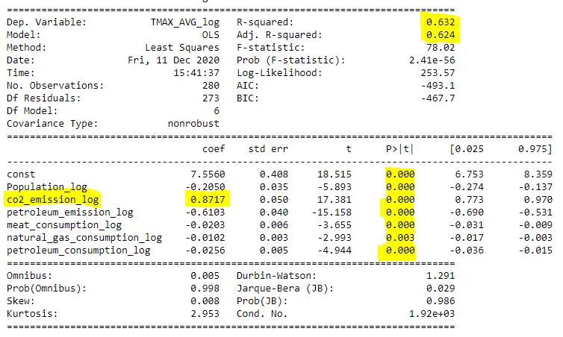
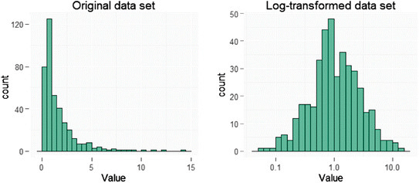
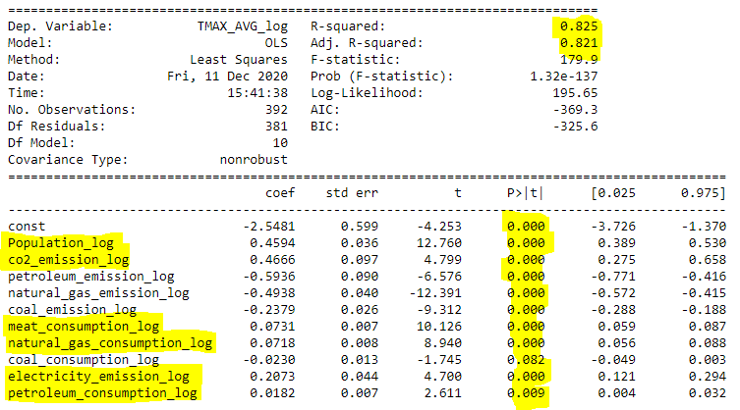
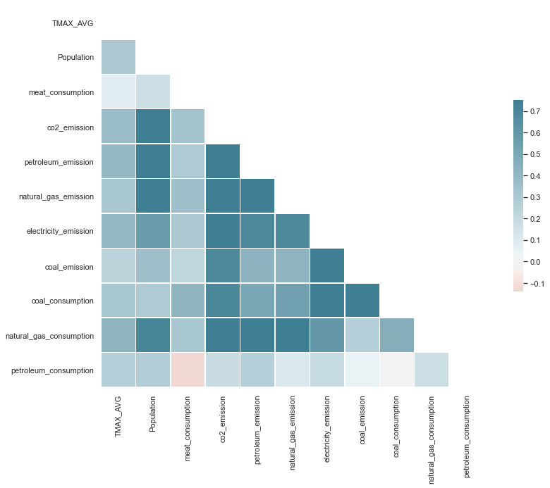
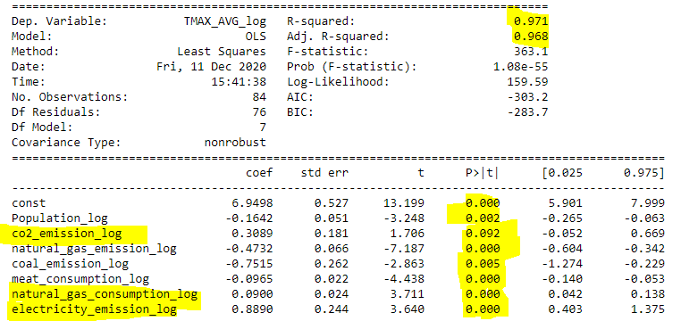
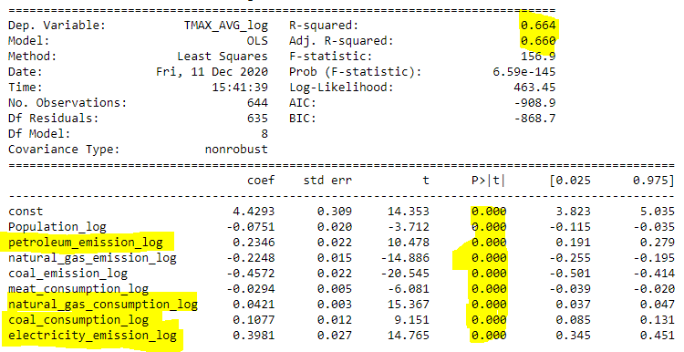
Statistical Model
Log transformation
1
2
Correlation Matrix
3
4
Notes:
Statistical models are build on each of the clusters. Log transformation is taken both on the dependent and independent variables to satisfy the normal distribution assumption in regression. Correlation matrix helped to identify multi-collinearity and remove independent variables that high correlation among them. To the right hand side we have 4 regression models, one for each cluster.

Slide 21
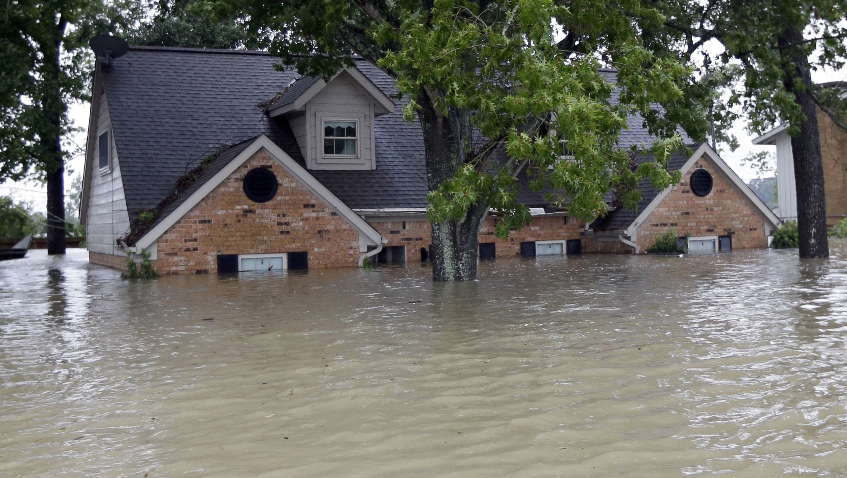
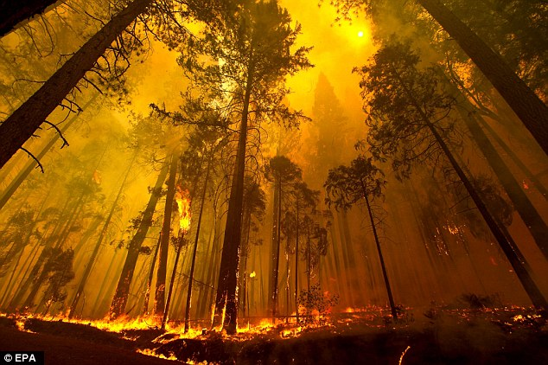
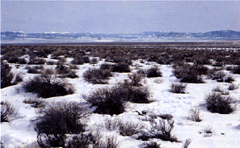

Statistical Model Results
WET STATES
GLOBAL WARMING STATES
COLD & DRY STATES
UNPREDICTABLE WEATHER
STATES
New Jersey, New York, Connecticut,
Massachusetts, Maryland ….
California, Alaska, Nevada, Michigan,
Oregon, Wisconsin, South Dakota….
Arizona, New Mexico and Colorado
Florida, Texas, Illinois, Kansas, Ohio,
Tennessee, Virginia, Los Angeles….
CO2 Emission 61%
Population 59%
CO2 Emission 16%
Natural Gas Consumption 10%
Meat Consumption 9%
Electricity Emission 5%
Petroleum Consumption 2%
Electricity Emission 53%
CO2 emission 22%
Natural Gas Consumption 25%
Coal Consumption 35%
Electricity Emission 32%
Petroleum Emission 18%
Natural Gas Consumption 14%
Notes:
The top factors identified for each of the clusters are –
CO2 emission for Wet states such as NJ,NY and human interference represented by population in global warming states such as California, Alaska.
Electricity carbon emission in Arizona, New Mexico and Colorado. Coal consumption and electricity consumption in Florida, Texas and other states in the cluster

Slide 22
Prediction
Notes:
Next Aleks will walk us the prediction on some of the key factors identified.

Slide 23
Thank You

